Slide 1
TEAM:
Geekser CHALLENGE:
Earth Oceans- Trash Cleanup

Slide 2
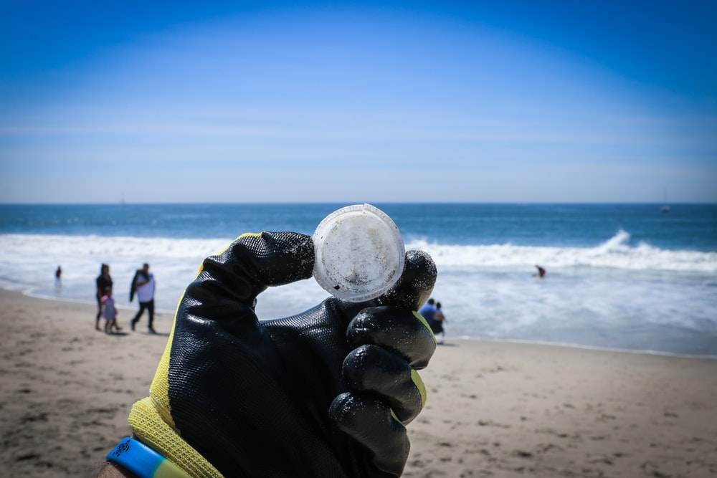
O C E A N P L A S T I C C L E A N E R

Slide 3
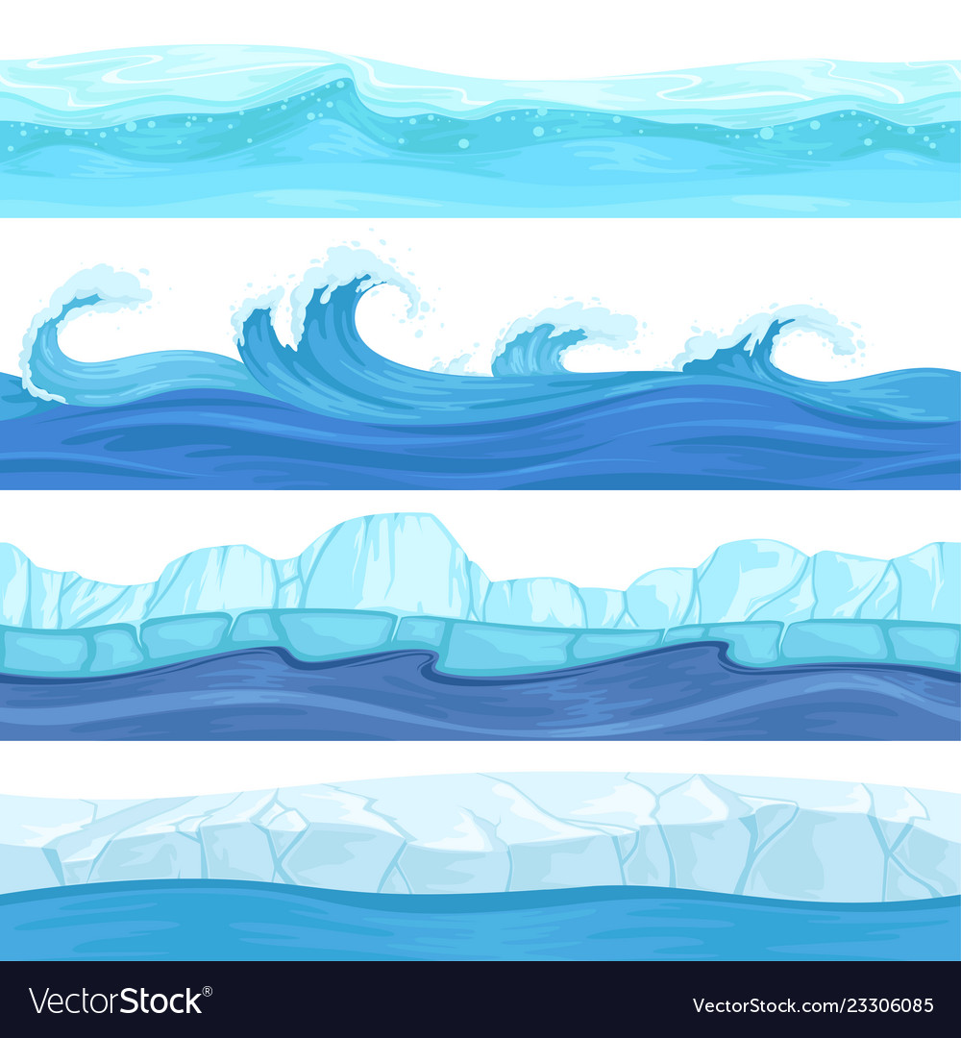
W H Y ?
Most of the oxygen in our atmosphere is generated by the Sea.
Oceanic activities control our climate and weather.
Oceans act as CO2 sink helped us to buffer human caused global warming.

Slide 4
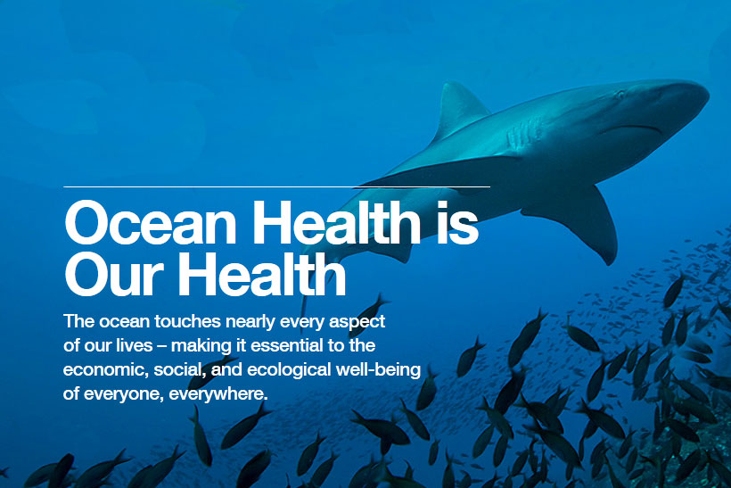
I T ' S U R G E N T C A L L

Slide 5
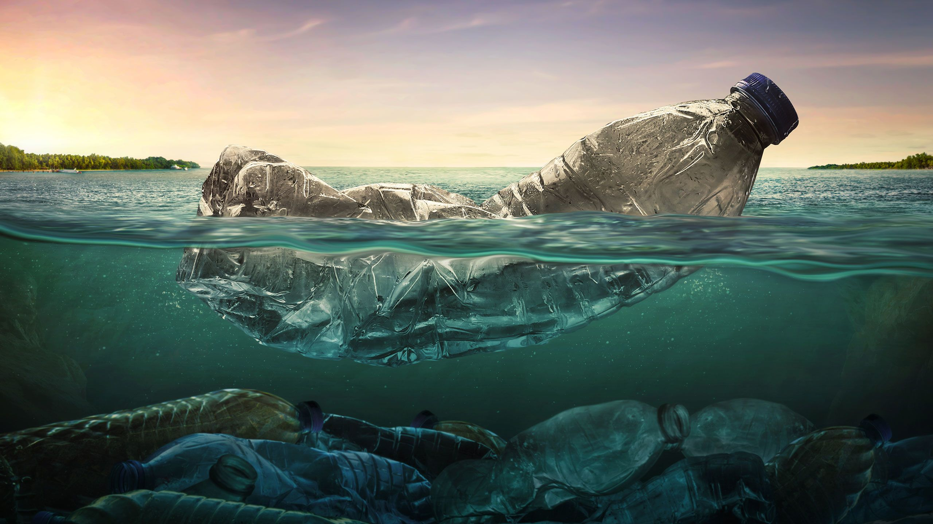
Plastics in Ocean are getting accumulated and is one of the major reason in declined health of our oceans.

Slide 6
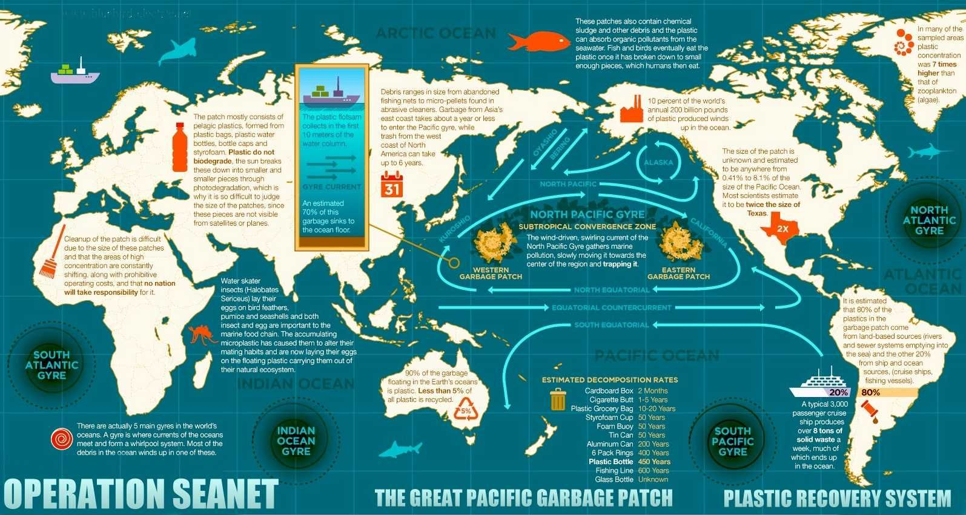
Garbage Patches: Great Pacific Garbage Patch Indian Ocean garbage patch North Atlantic garbage patch South Pacific garbage patch

Slide 7
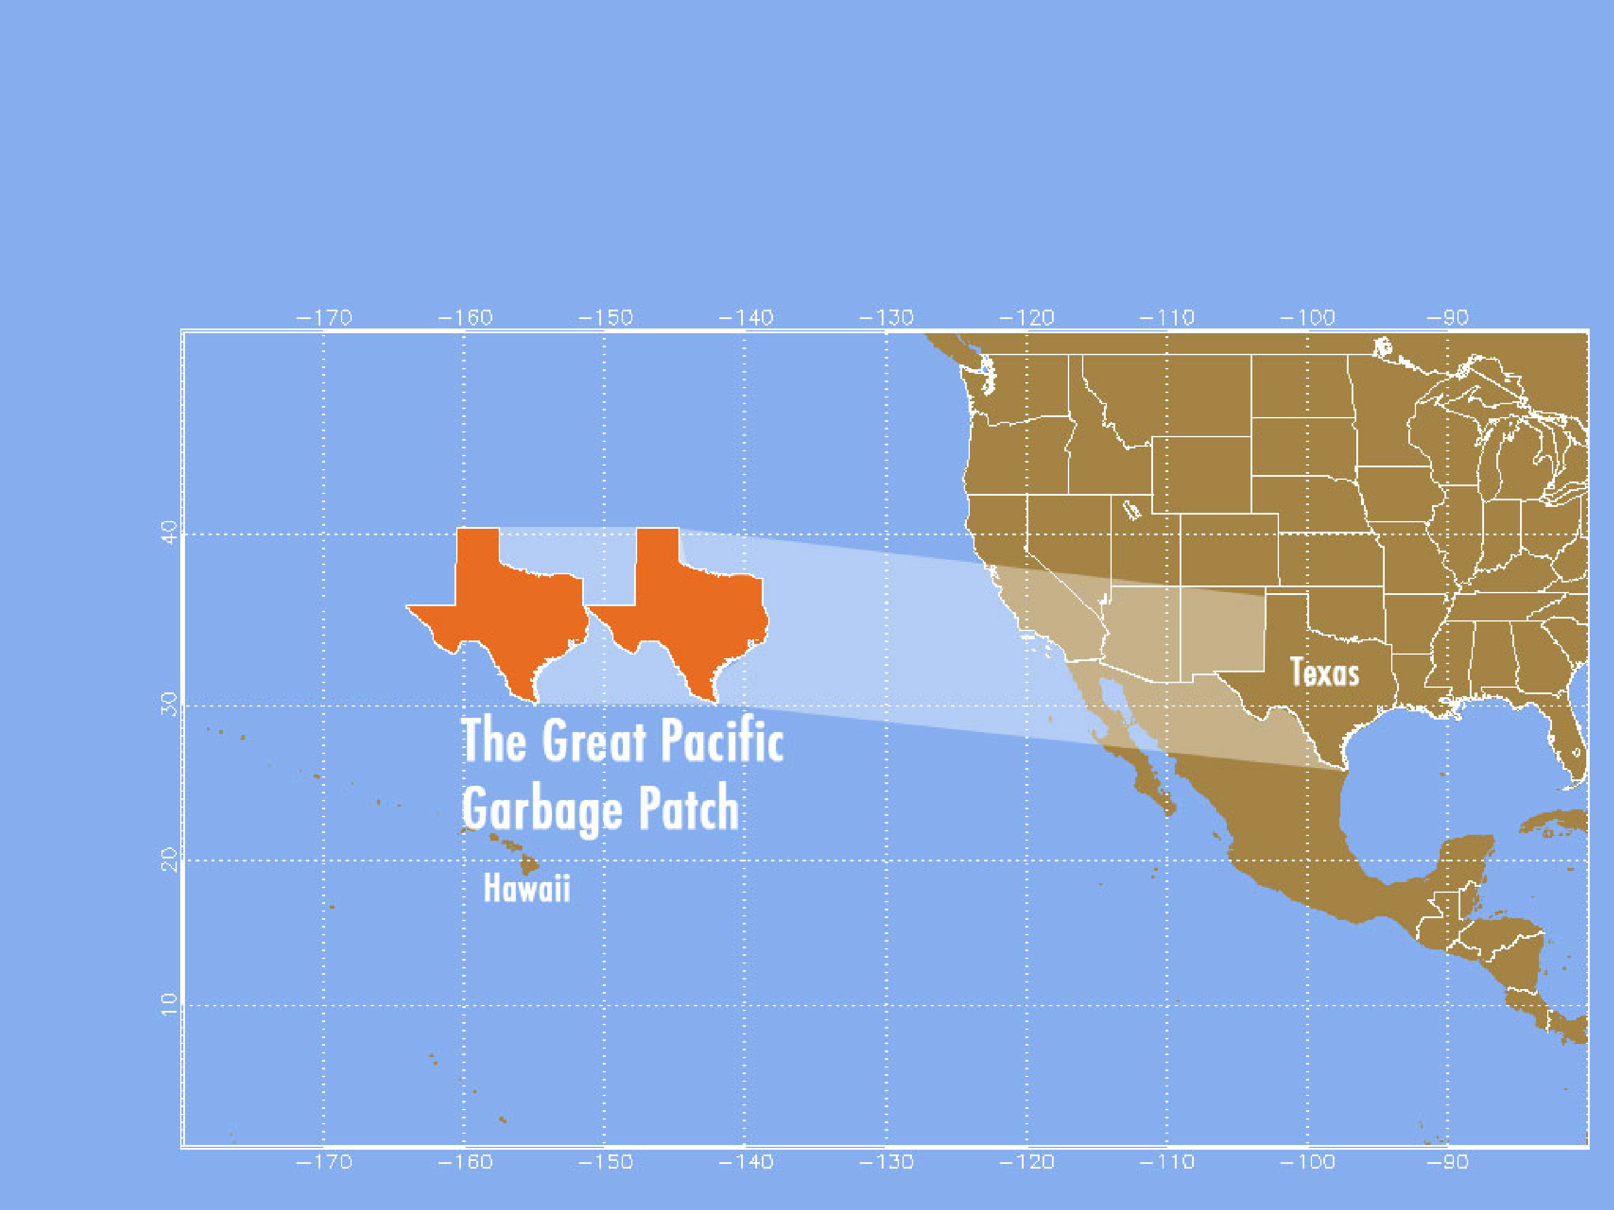
There is a garbage patch twice the size of Texas in the North Pacific Ocean. As we shown in our Google Earth Engine.....

Slide 8
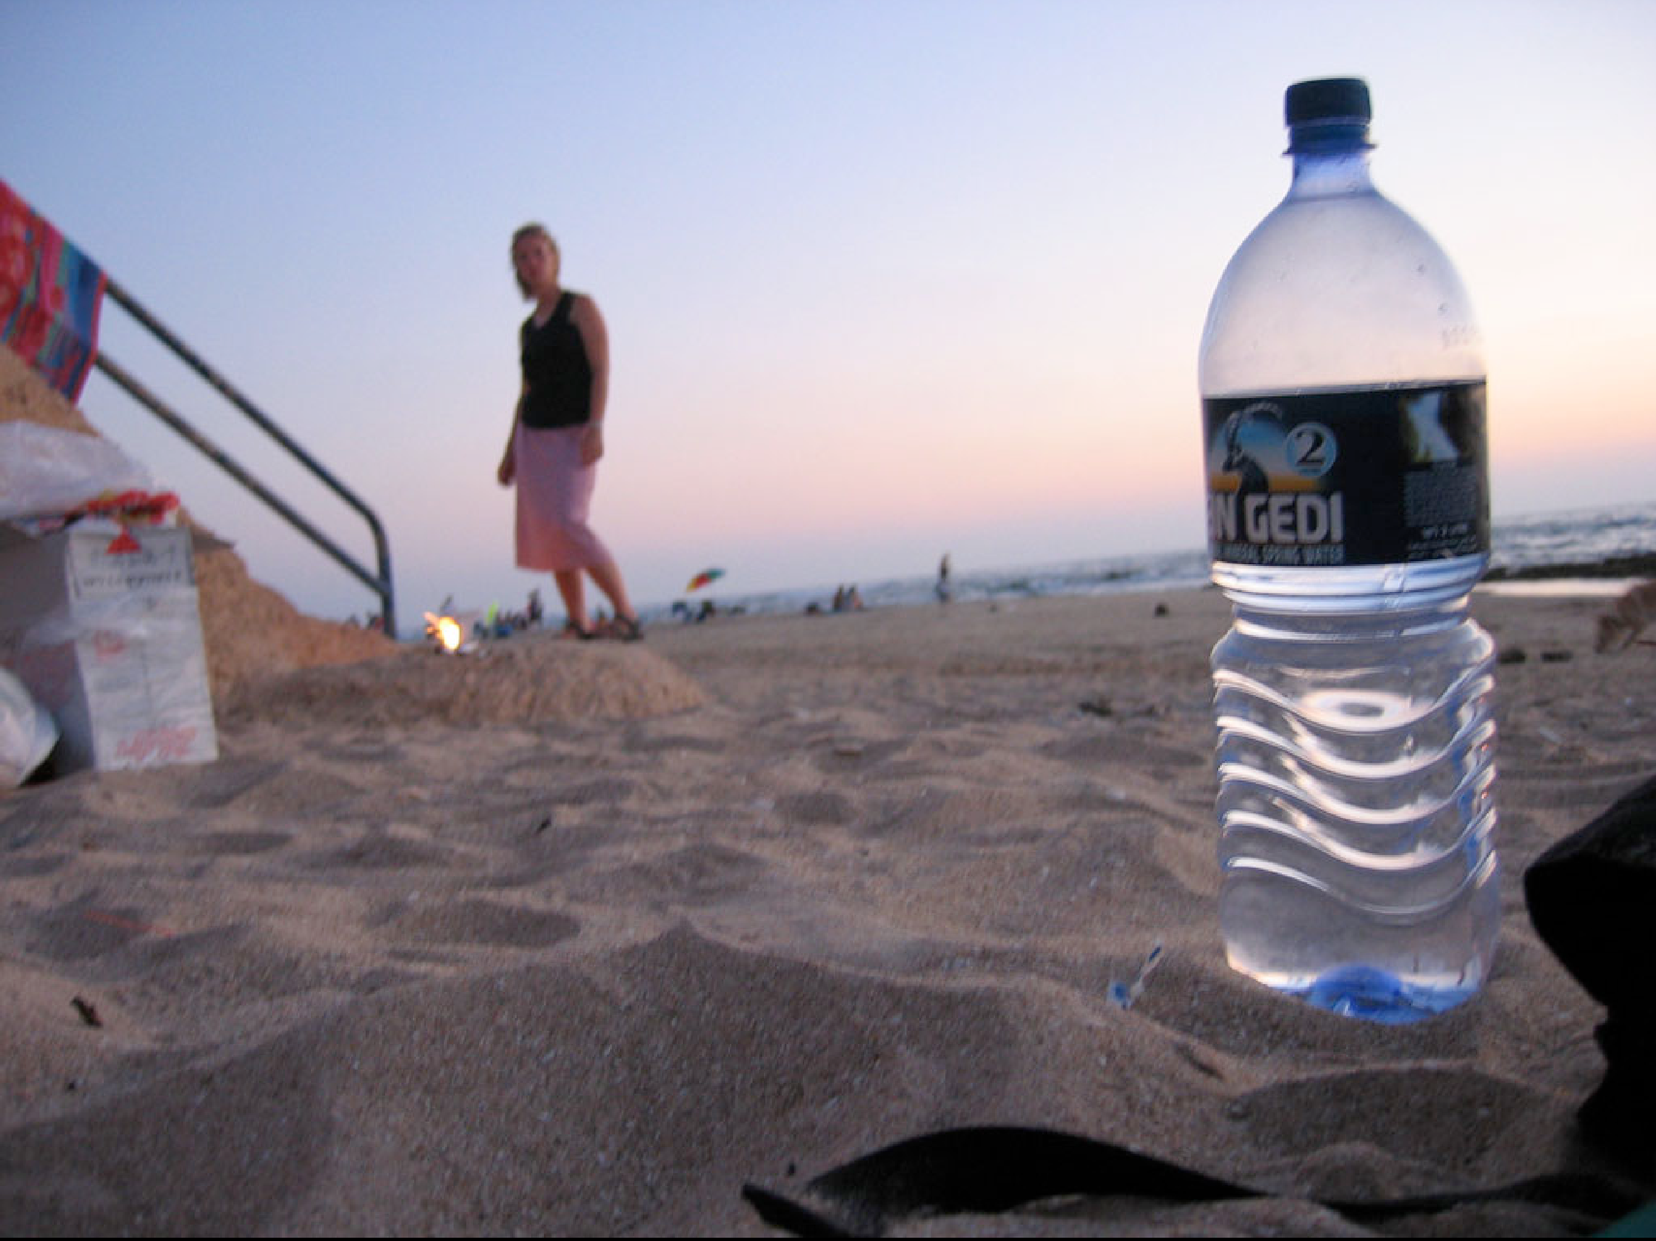
How can we as a Geekser help ??.... Let's dive into solution

Slide 9
Where to learn more
http://savetheocean.wordpress.com http://www.rozsavage.com/index.php/environment/pacific-stage-1-plastic-pollution http://www.filterforgood.com/
http://www.algalita.org/ http://www.healthebay.org

